Slide 1
TensorFlow python module
Group ID: DM21G12
2018BTECS00031 Sushil Wagh
2018BTECS00037 Abhishek More

Slide 2
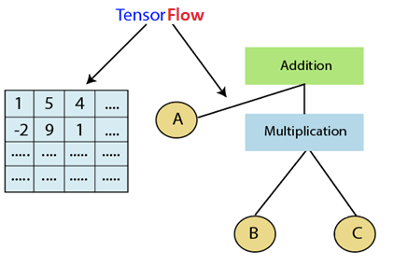
What is TensorFlow?
Framework for Deep Learning
Developed by Google Brain Team
Tensor + Flow

Slide 3
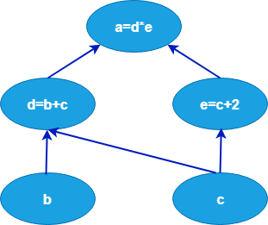
Components of TensorFlow
Graphs
Tensor
Session

Slide 4
Why is TensorFlow popular?
accessible to everyone
based on graph computation
provides APIs for Python, C++, Haskell, Java, Go, Rust, and there’s also a third-party package for R called tensorflow.

Slide 5
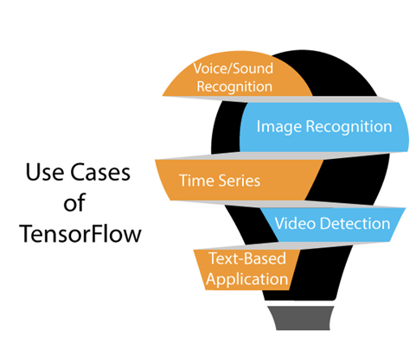
Use Cases/Applications of TensorFlow
Voice/Sound Recognition
Image Recognition
Time Series
Video Detection
Text-Based Applications

Slide 6
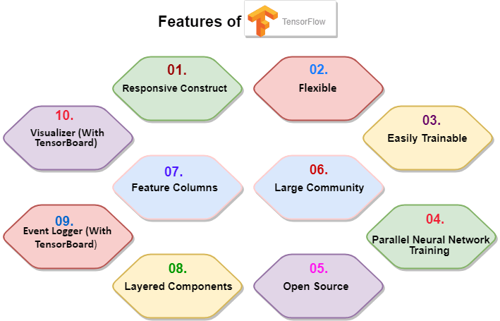
Features of TensorFlow
Responsive Construct
Flexible
Easily Trainable
Parallel Neural Network Training
Large Community
Open Source
Feature Columns
Availability of Statistical Distributions
Layered Components
Visualizer (With TensorBoard)
Event Logger (With TensorBoard)

Slide 7
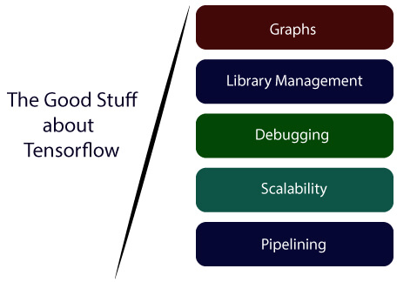
Advantage of TensorFlow
Graphs
Library Management
Debugging
Scalability
Pipelining

Slide 8
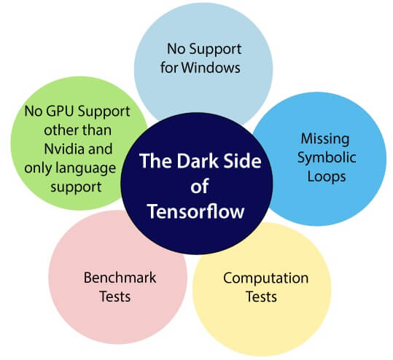
Disadvantage of TensorFlow
Missing Symbolic loops
No supports for windows
Benchmark tests
No GPU support other than Nvidia
Computation Speed

Slide 9
References
https://www.tensorflow.org/tutorials
https://towardsdatascience.com/the-complete-tensorflow-tutorial-for-newbies-dc3acc1310f8
https://towardsdatascience.com/beginners-guide-to-deep-learning-with-tensorflow-ca85969b2f2

Slide 10
Thank You

